Slide 1
Ecosystem approach to Opioid Crisis
Anmol Bajaj
Shrikant Mudholkar
Soham Dasneogi

Slide 2
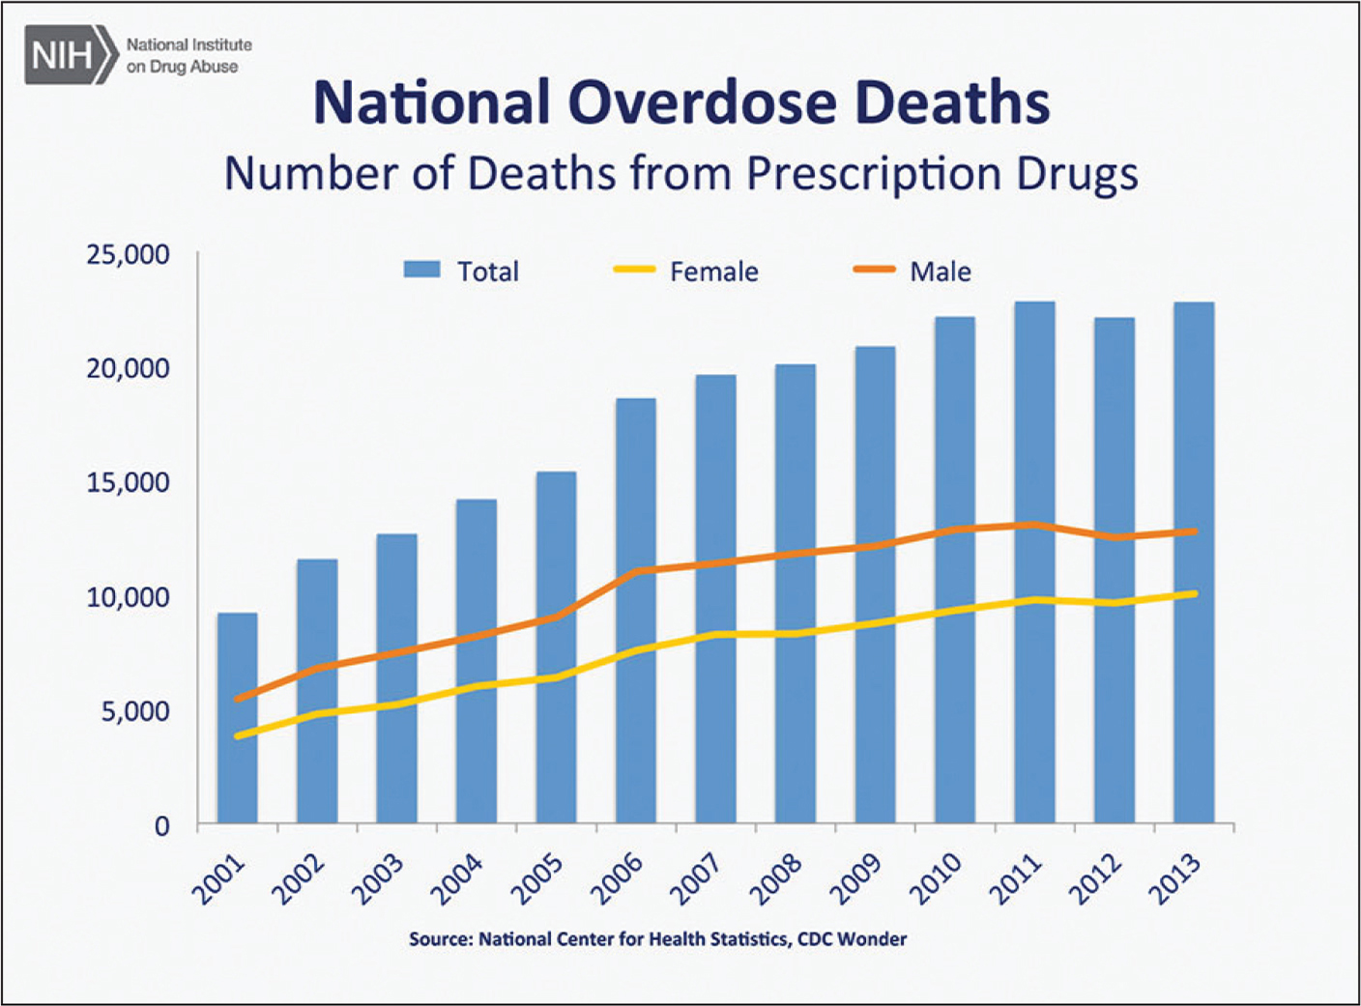
Problem Statement
The opioid and heroin epidemic touches nearly every American. Some are prescribed opioids for pain relief, some are battling opioid dependency and addiction, while others have lost a loved one to an overdose
The number of prescriptions for opioids has gone from 76 million in 1991 to nearly 207 million in 2013. In 2014, there were approximately one-and-a-half times more drug overdose deaths than deaths from motor vehicle crashes
We are creating ecosystem application that would give us insights into the root cause of the problem and help us find innovative ways to fight this evil crisis.

Slide 3

Stakeholders
Hospital
Pharmacy
Pharmaceutical Company
Drug Enforcement Administration
Community Rehabilitation Center

Slide 4
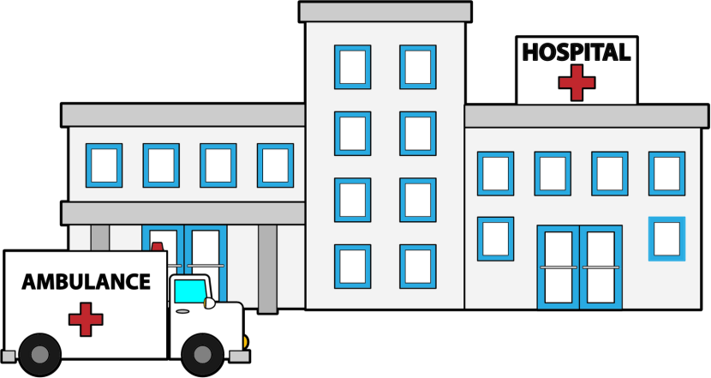
Hospital Enterprise
Doctors can diagnose the patient and prescribe opioids if needed
Identify a pattern of opioid abuse and can recommend a patient to community rehab provider
Hospital enterprise can also see the breakdown of each opioid abuse symptom for its patients

Slide 5
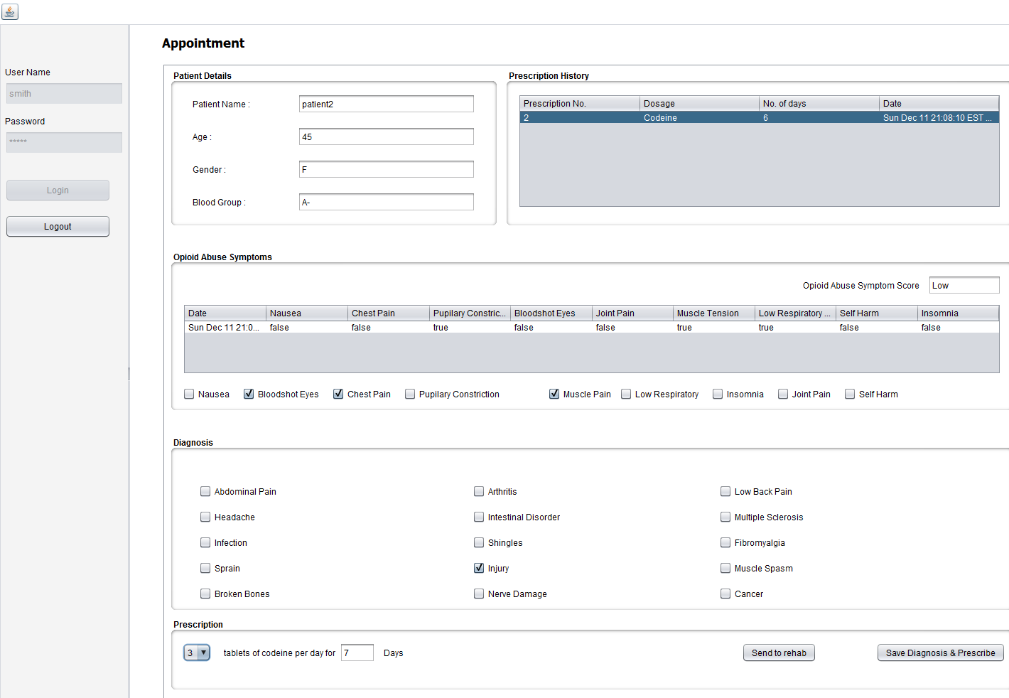

Patient Symptoms for various reports

Slide 6
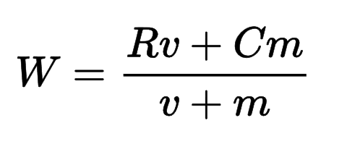
Bayesian Algorithm
A Bayesian average is a method of estimating the mean of a population where instead of estimating the mean strictly from the available data set, other information – especially a pre-existing belief with regard to the population which is a central feature of Bayesian interpretation – is incorporated into the calculation.
Bayesian Weighted rating (WR) = (v ÷ (v+m)) × R + (m ÷ (v+m)) × C
m = Total patients in the Ecosystem
v = Average of visits for all patients in the Ecosystem
c = Total symptom score for current patient
R = Average symptom score of all patients in the Ecosystem

Slide 7

Pharmacy Enterprise
Pharmacy Enterprise will manage its Chemist Organization
The Pharmacy will be able to sell opioids to the patients based on the prescriptions, Pharmacy has a global prescription list of all the patients which has the total number of opioids prescribed by any doctor
Pharmacy can communicate with Pharmaceutical Enterprise to order opioids to manage its own stock

Slide 8

Pharmaceutical Company Enterprise
Pharmaceutical Company Enterprise gets work requests from Pharmacy Enterprise
Based on the work requests, they dispatch the opioids to the Pharmacy and maintains a record

Slide 9

Community Rehabilitation Centers
These enterprises accept work requests that contain patients sent for rehabilitation from hospital enterprises
They also collect data on admitted patients about their recovery, such as other addictions they might have picked up post opioid abuse
Rehab Centers also keep a track of a patient’s withdrawal symptoms during their recovery from opioid addiction

Slide 10
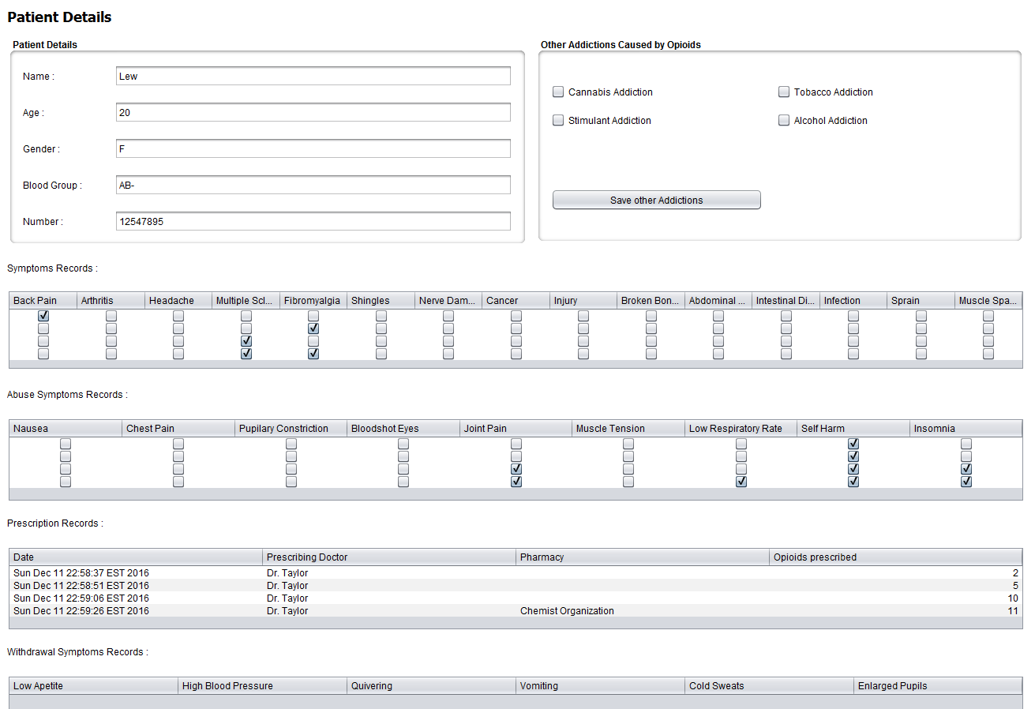


Slide 11

Drug Enforcement Administration
The Drug Enforcement Administration (or simply DEA) finds the doctors guilty of malpractice, i.e. the doctors who prescribe opioids to patients that are showing signs of addiction and pushing them towards abuse
The DEA also looks for pharmacies that sell opioids to individuals without prescriptions, thus enabling their addiction
It also looks for pharmacies that are most frequented by patients, to see if a particular pharmacy might be dealing opioids under the table

Slide 12
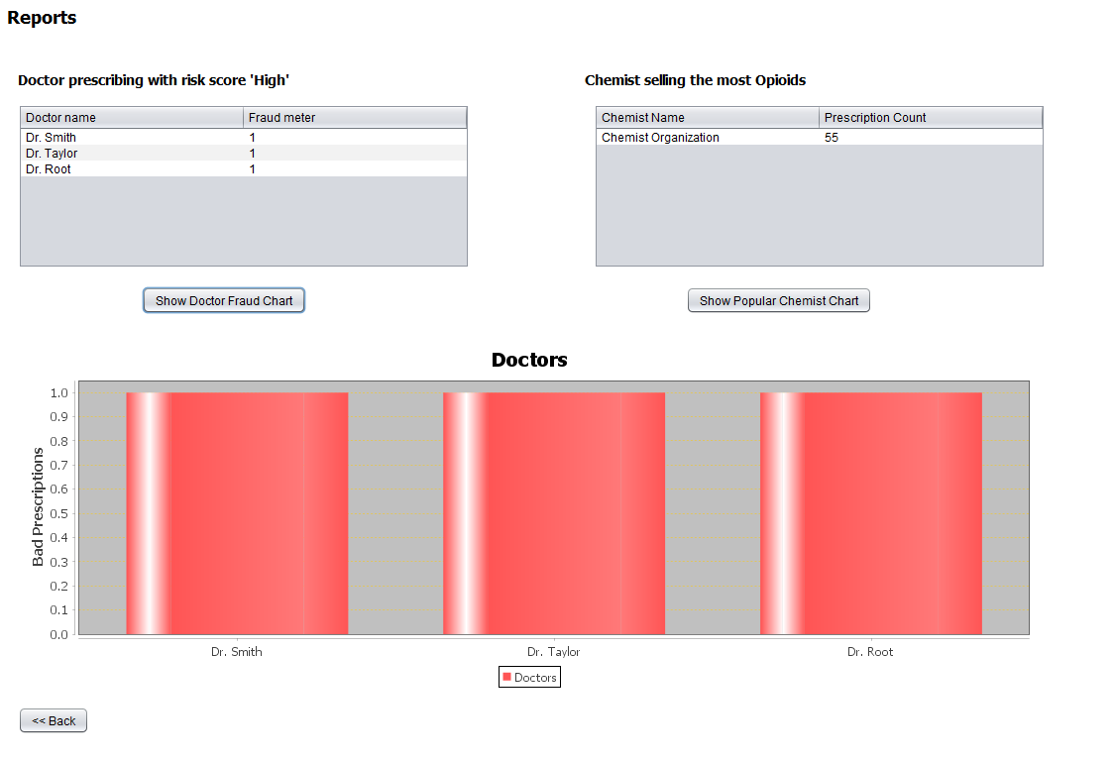
DEA Reports

Slide 13



Our Approach
An ecosystem approach could be the best hope in the battle against opioid addiction. From engaging new partners and aligning action across the ecosystem, to using data analysis, driving innovation, and using markets to support sustainable solutions, the ecosystem is likely to generate a powerful response.
This collaborative approach inspires all stakeholders to act as a single, integrated community and point the way toward powerful new solutions.

Slide 14
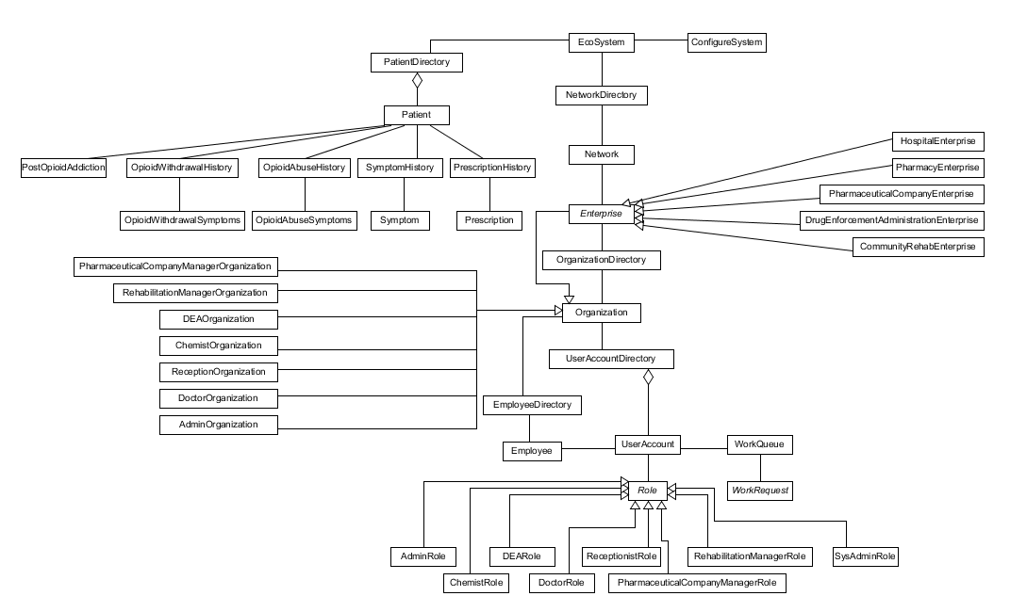

Slide 15
Reports
Opioids prescribed per Diagnosis symptom for addicts
Common abuse symptoms breakdown in addicts
Abuse symptoms of patients which are most prescribed with opioids
Patients score status with highest abuse symptoms for Low, medium, high scores
Pharmacies with discrepancy in opioid stock
Doctors prescribing opioids even if the patient shows a pattern of abuse
Pharmacies which are popular amongst the addicts
Abuse symptom breakdown for a hospital

Slide 16
Thank you!

